Slide 1

Usage of selectors in Redux

Slide 2
Why Selectors?
Seperation of all the computational work. Returns computed data
1
Resuability, i.e decoupled from a specific container
2
Memoized, i.e cached for unchanged data
3
Testing functionality.
4

Slide 3
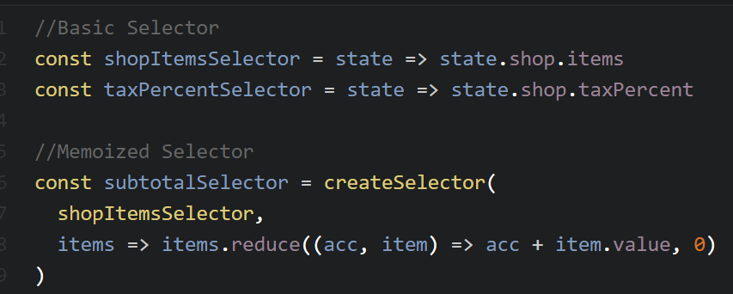
when you use the createSelector() function, it memoizes an output of every input selector and recalculates the resulting value only if any of the input selectors changes its output. An important thing to note here is that reselect uses reference equality (===) to determine a value change. Reselect only memoizes on the most recent inputs (ie, it has a cache size of 1).
In other words implementing in each react component
shouldComponentUpdate(nextProps) = {
return this.props !== nextProps;
}

Slide 4
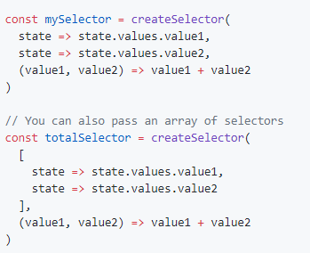
Example

Slide 5
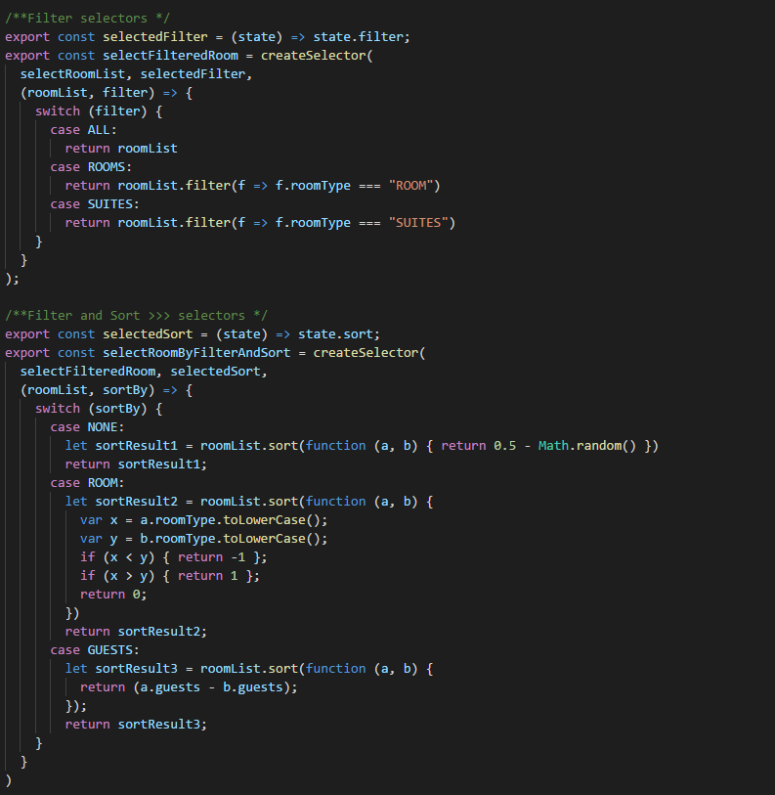
Nested selectors

Slide 6
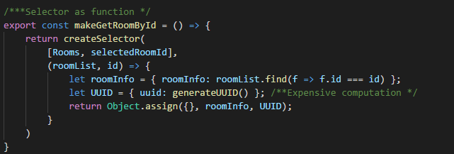
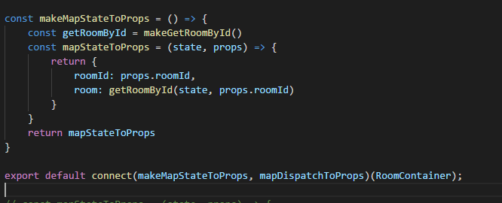
Selector as function

